Slide 1
YouTube
CHANNEL
USER
VIDEO
Bilge Duygu & Nihan Dilara Yürüten
MUSIC
ALBUM
SINGER

Slide 2
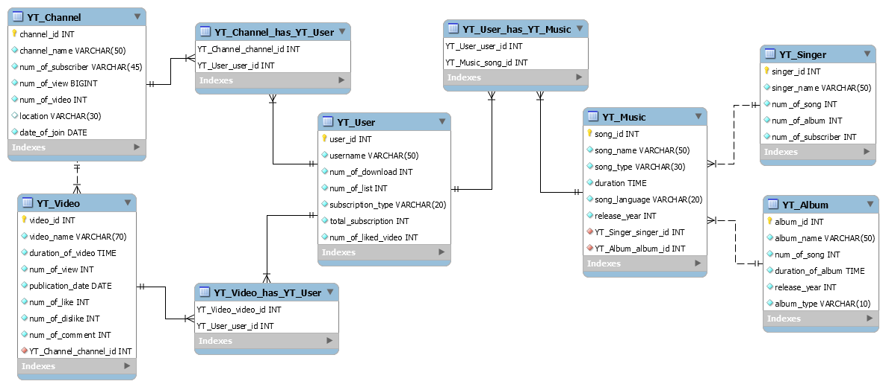

Slide 3
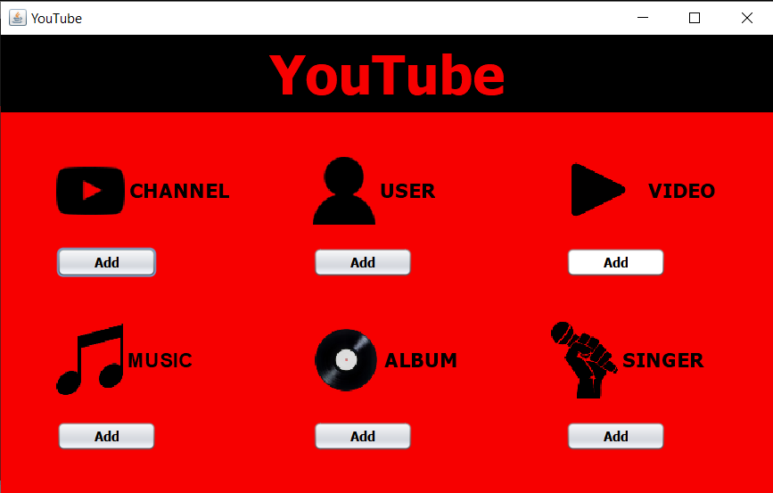

Slide 4
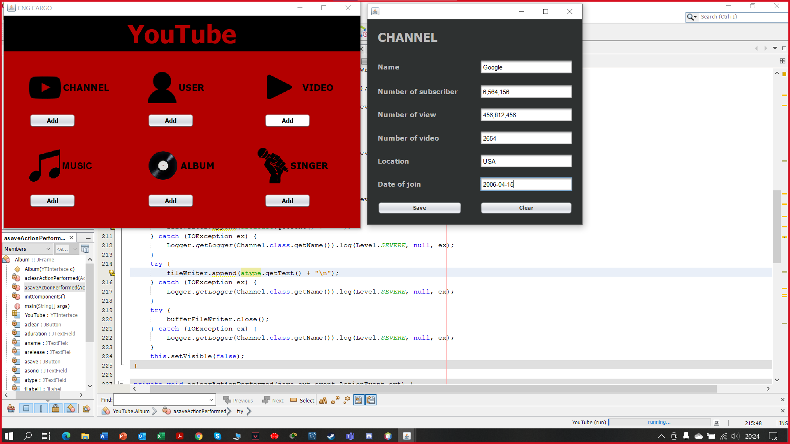
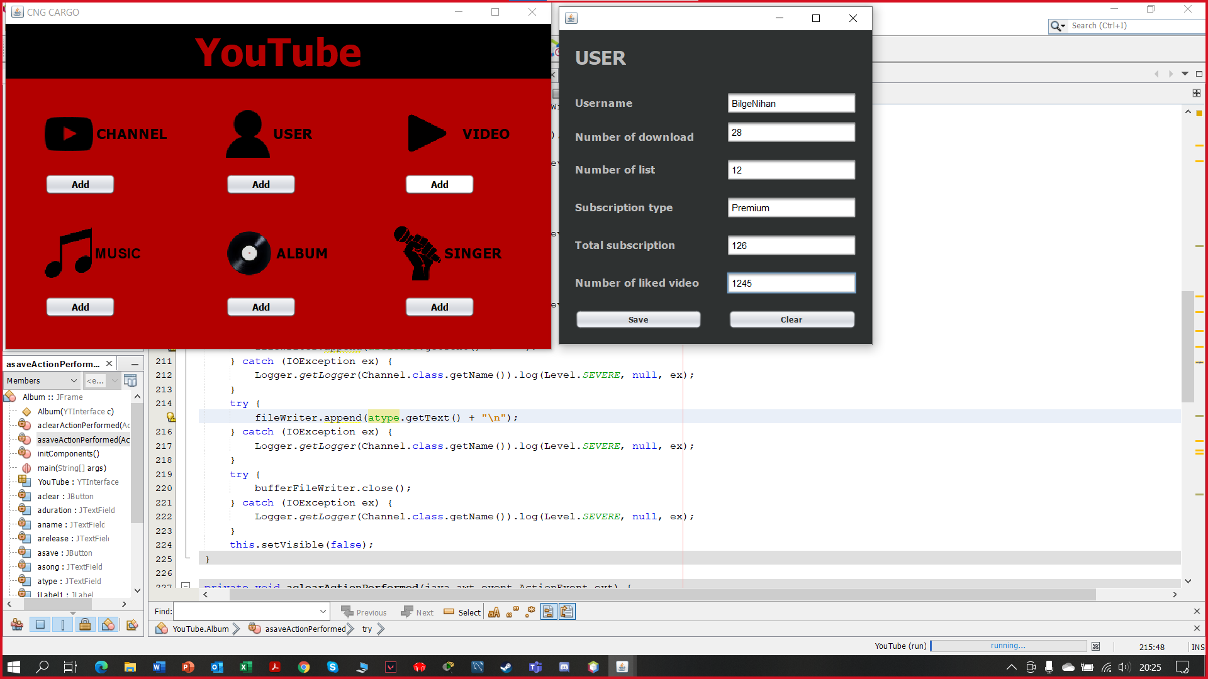

Slide 5
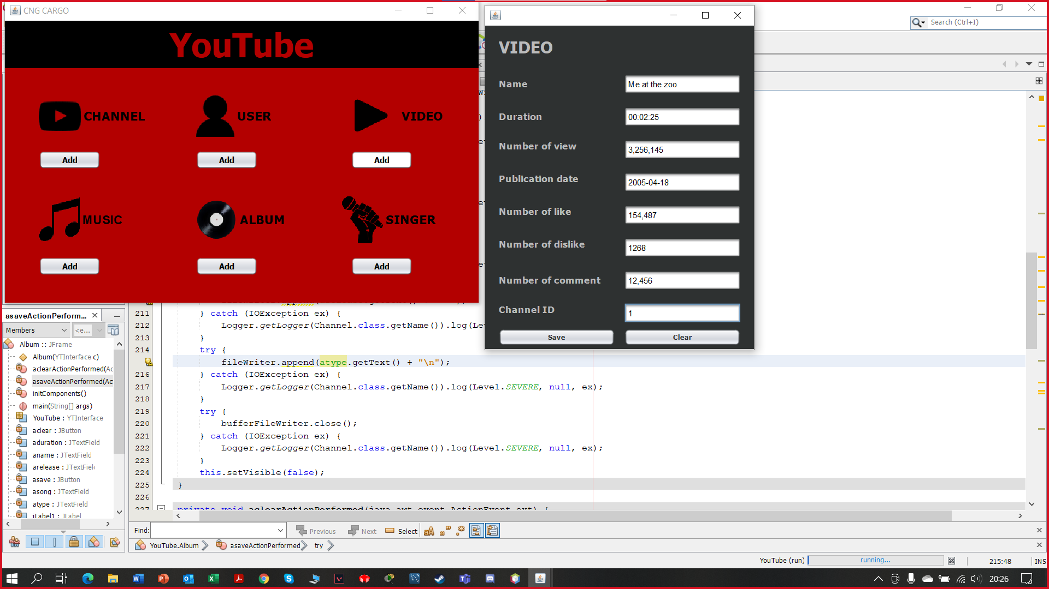
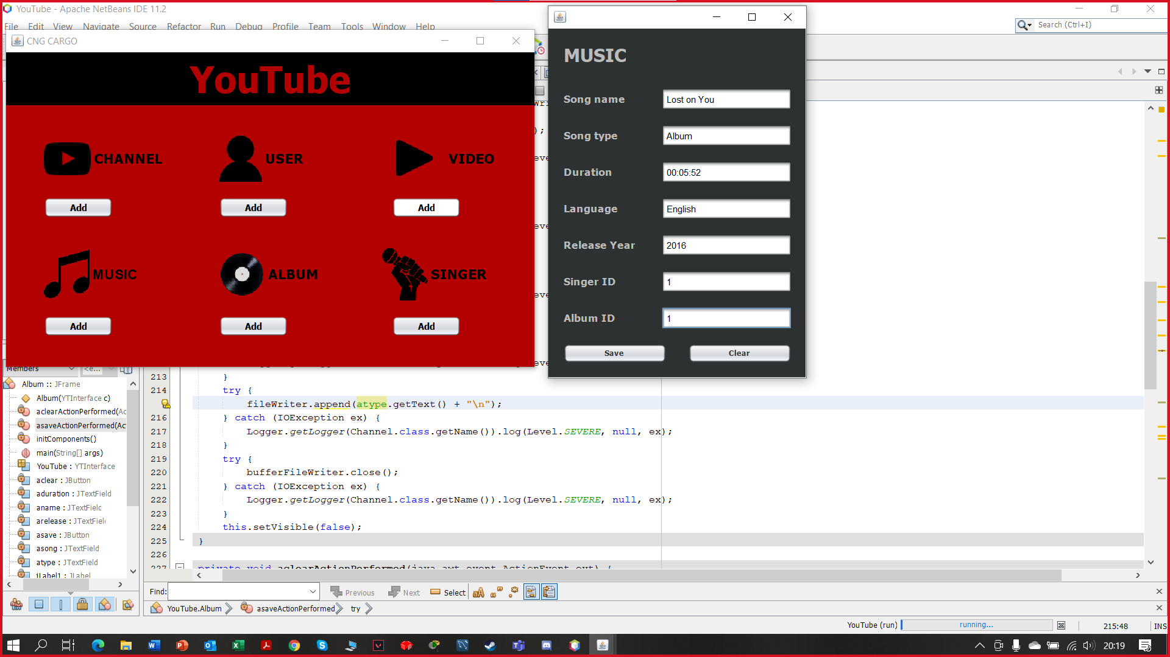
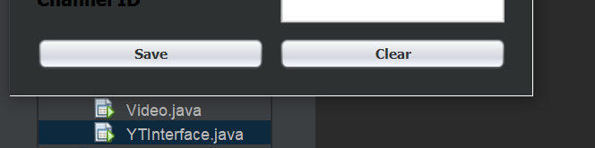

Slide 6
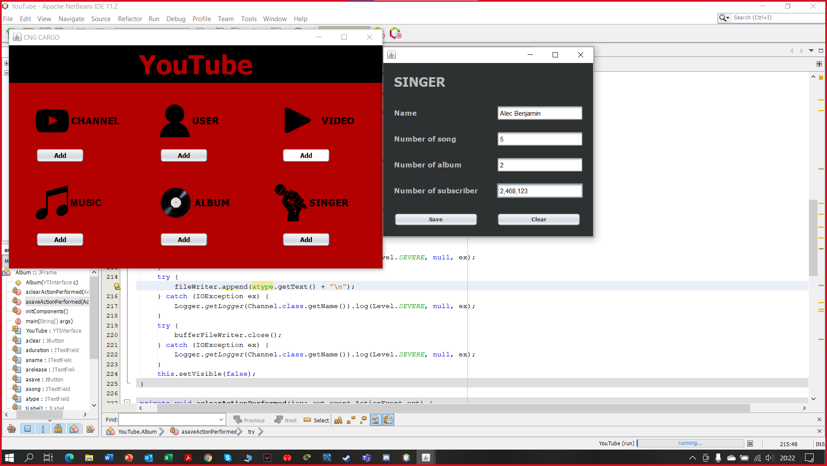
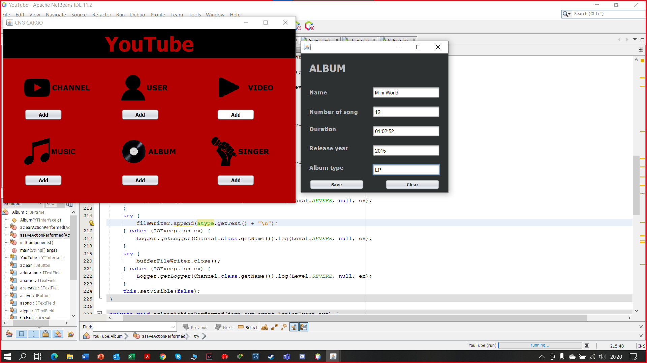
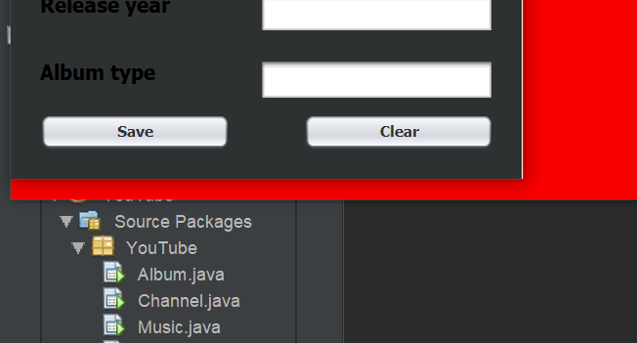

Slide 7
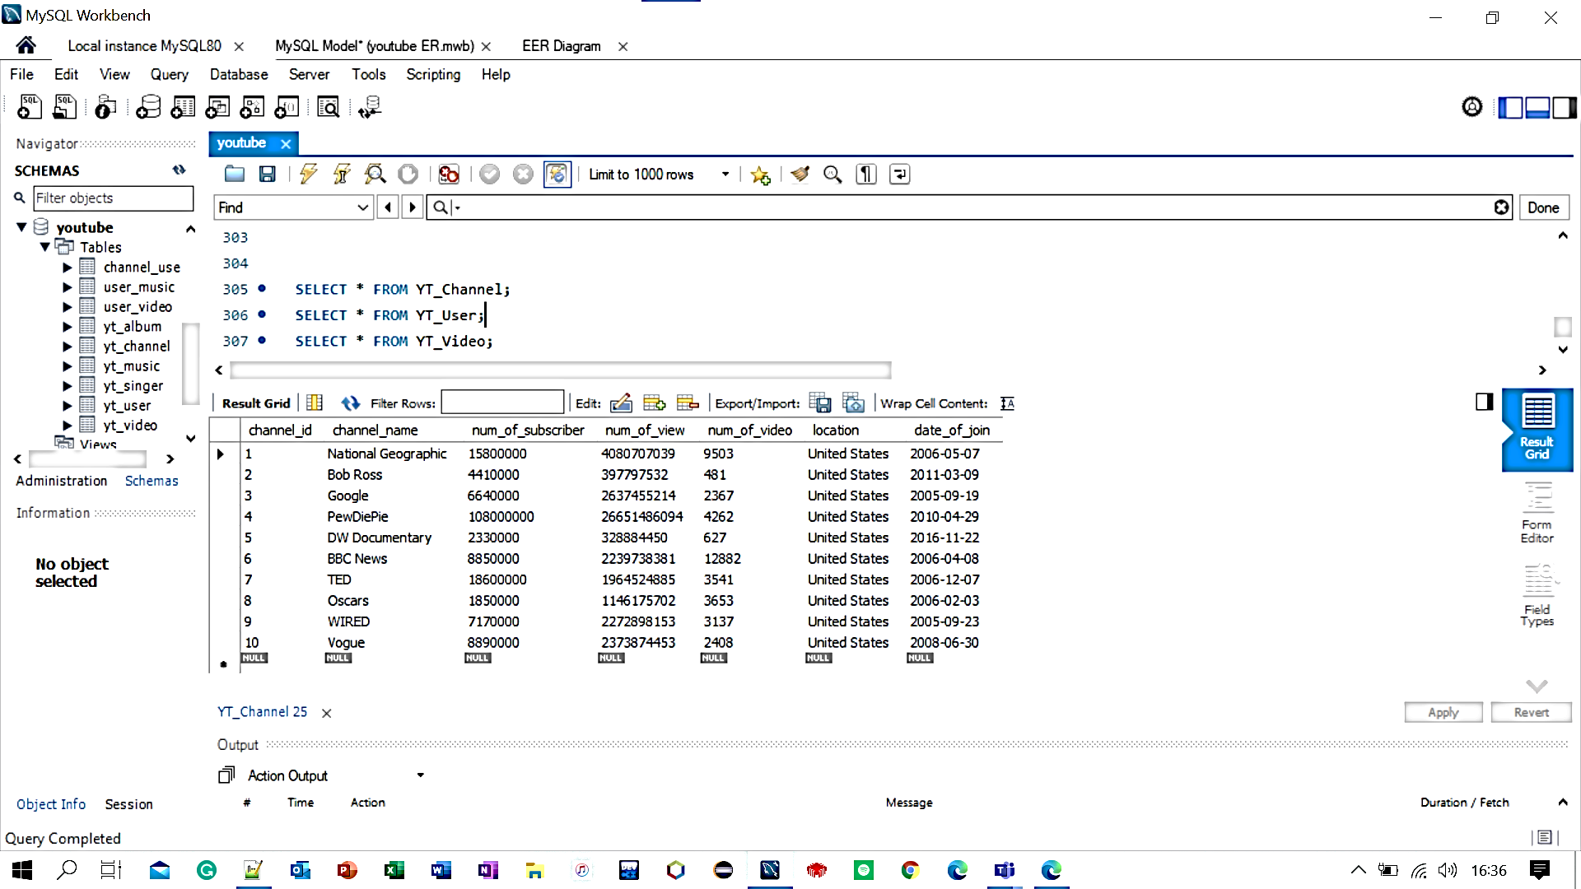
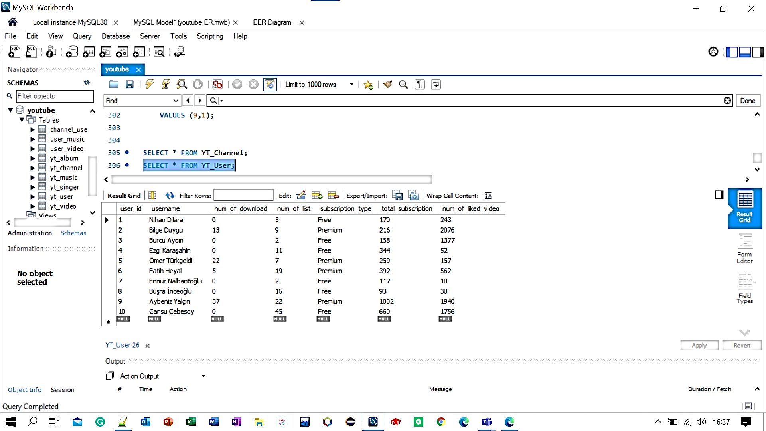
CHANNEL
USER

Slide 8
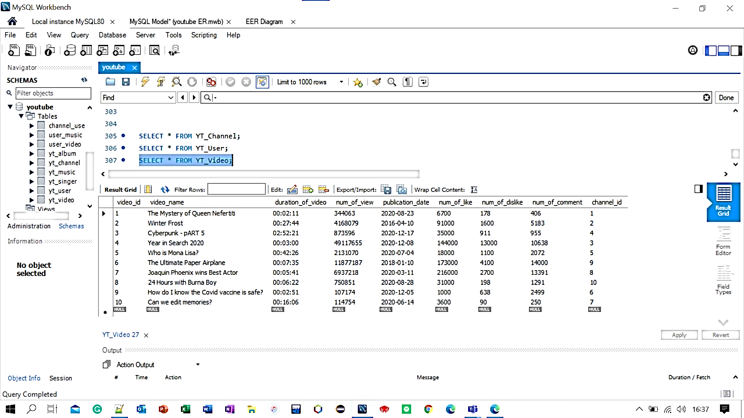
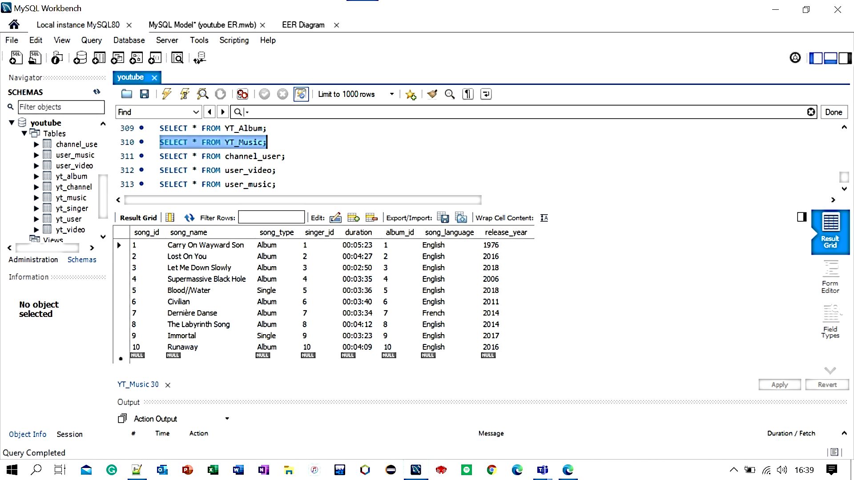
VIDEO
MUSIC

Slide 9
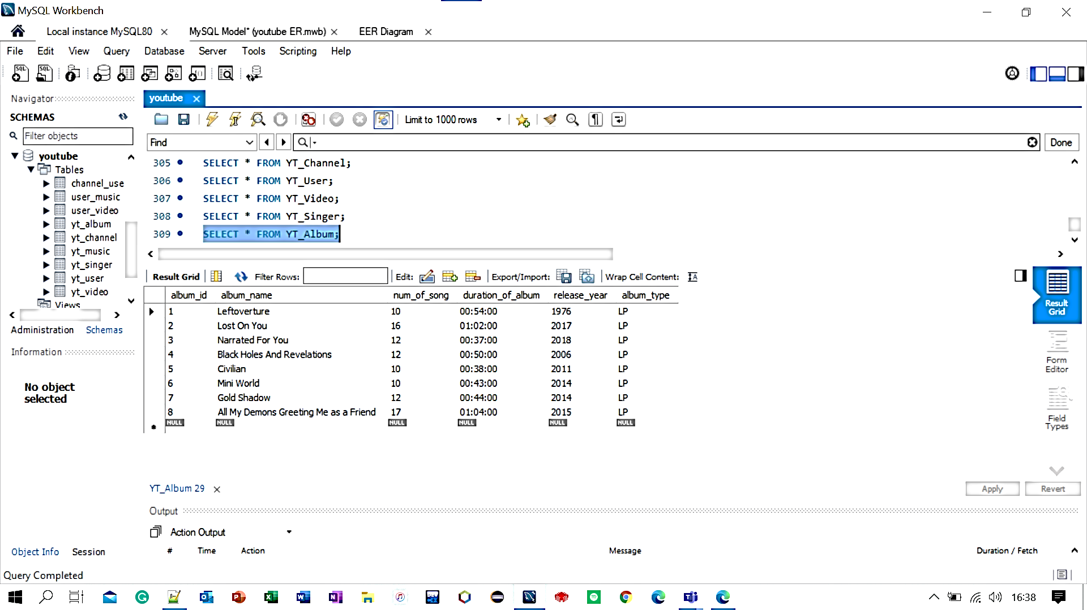
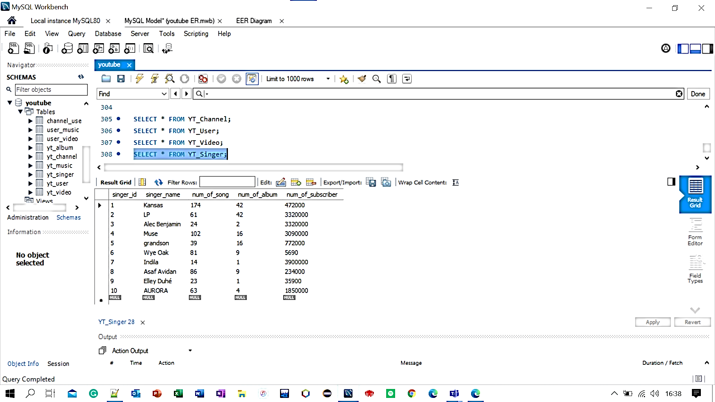
ALBUM
SINGER

Slide 10
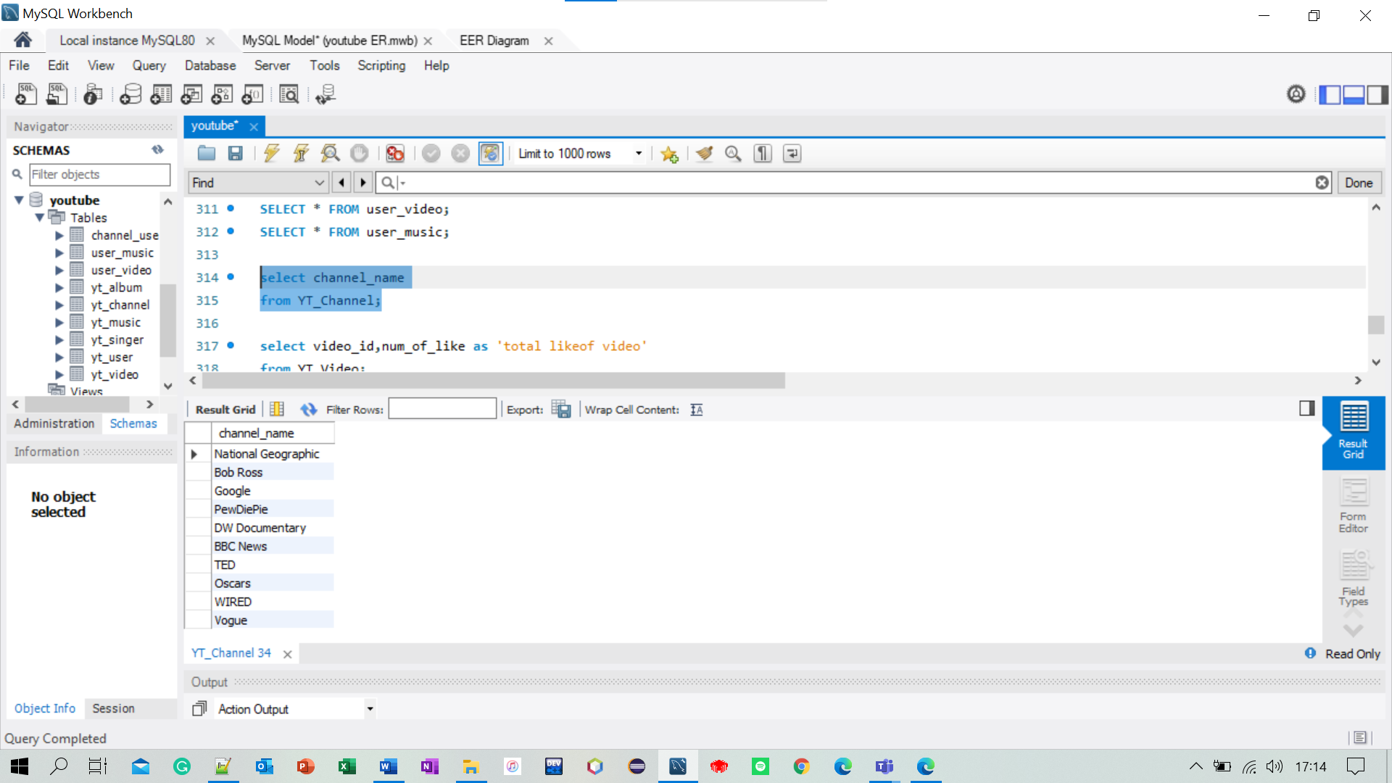
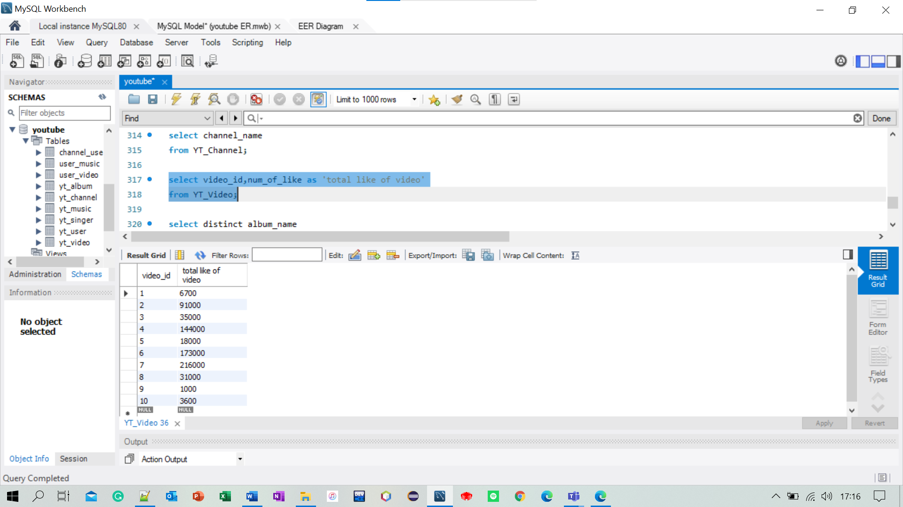
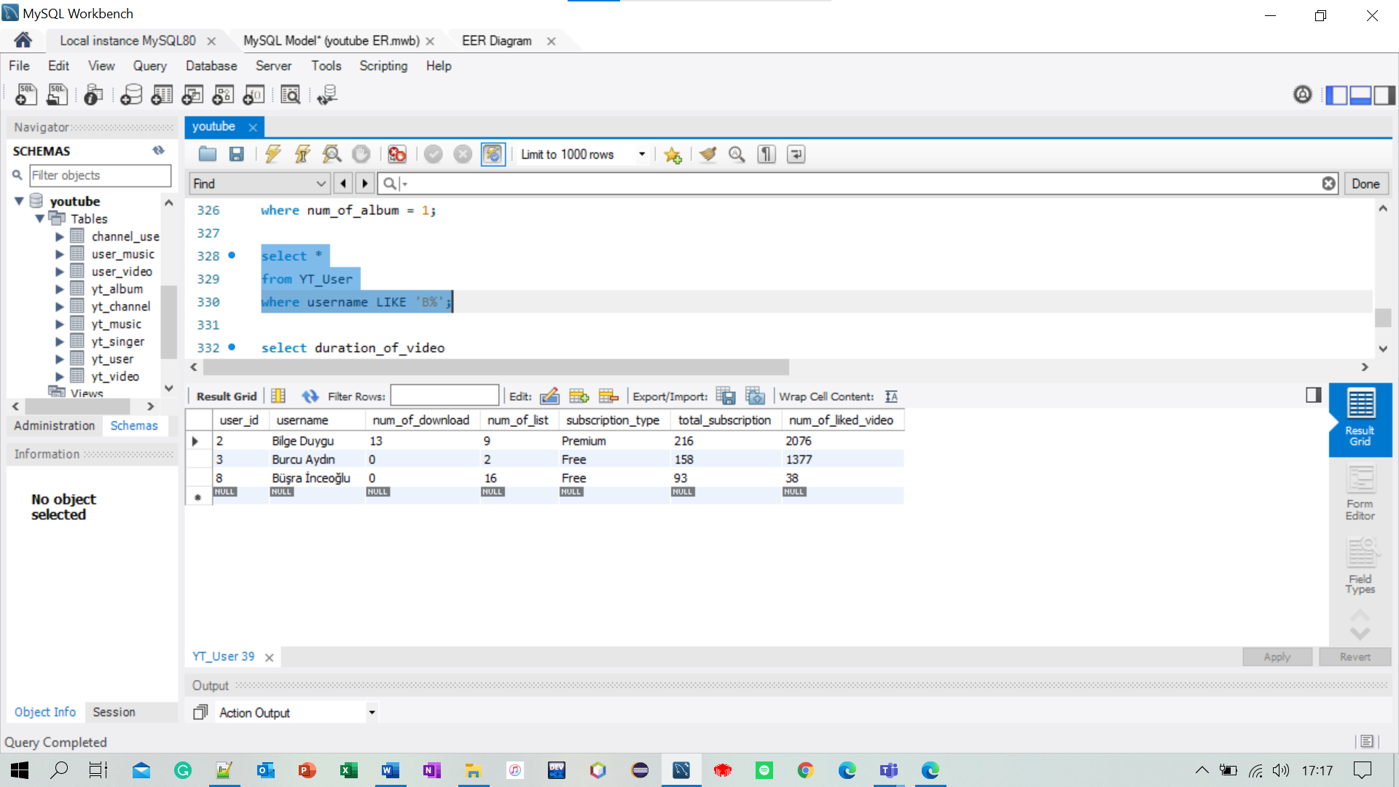
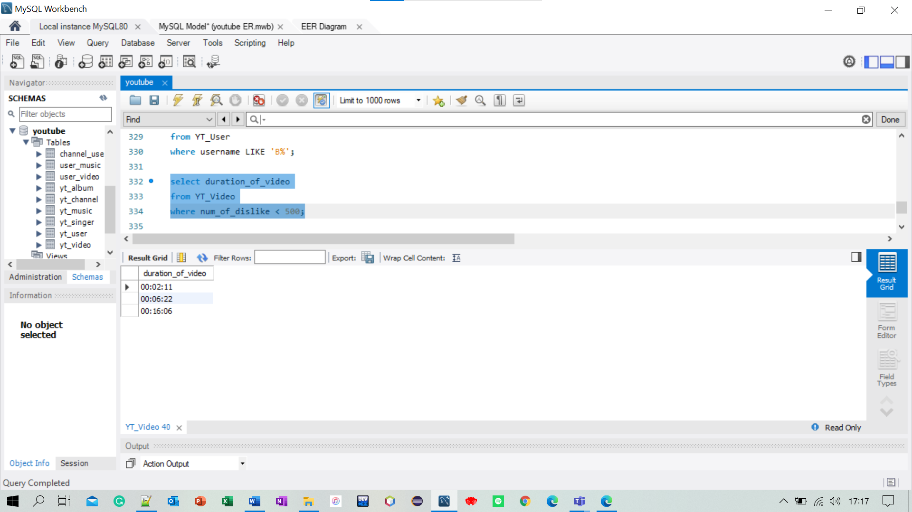
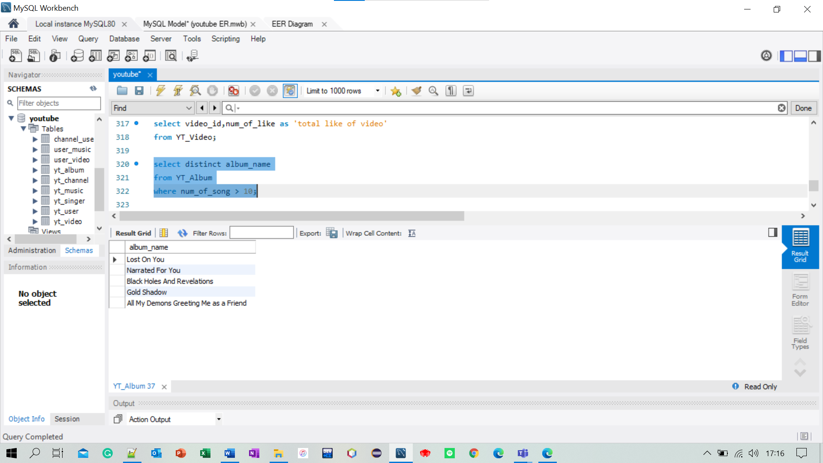
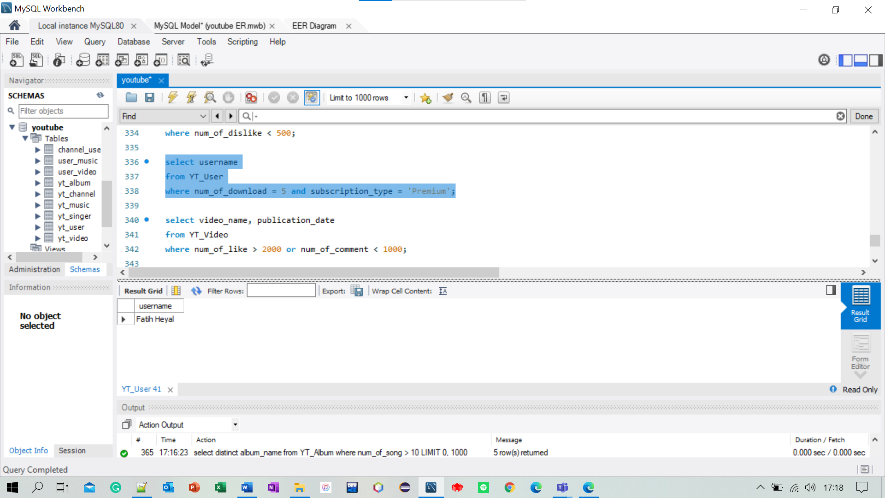
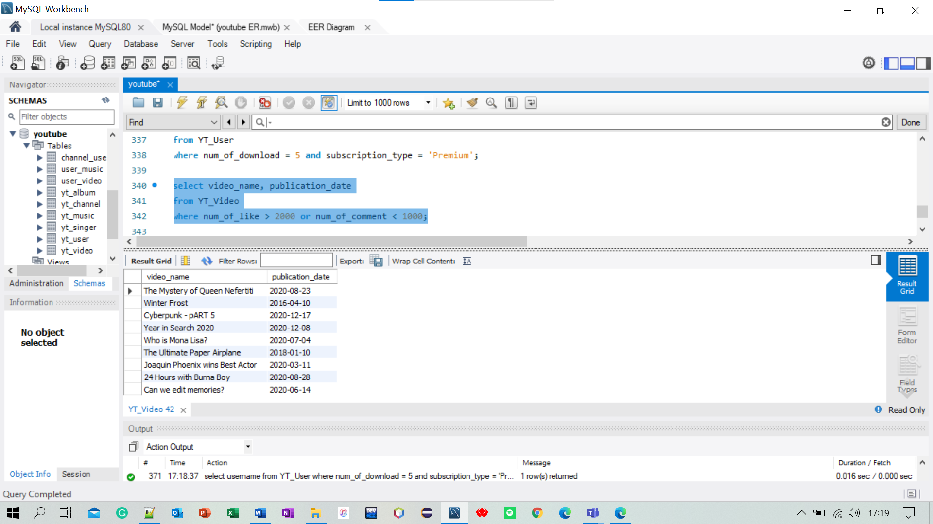
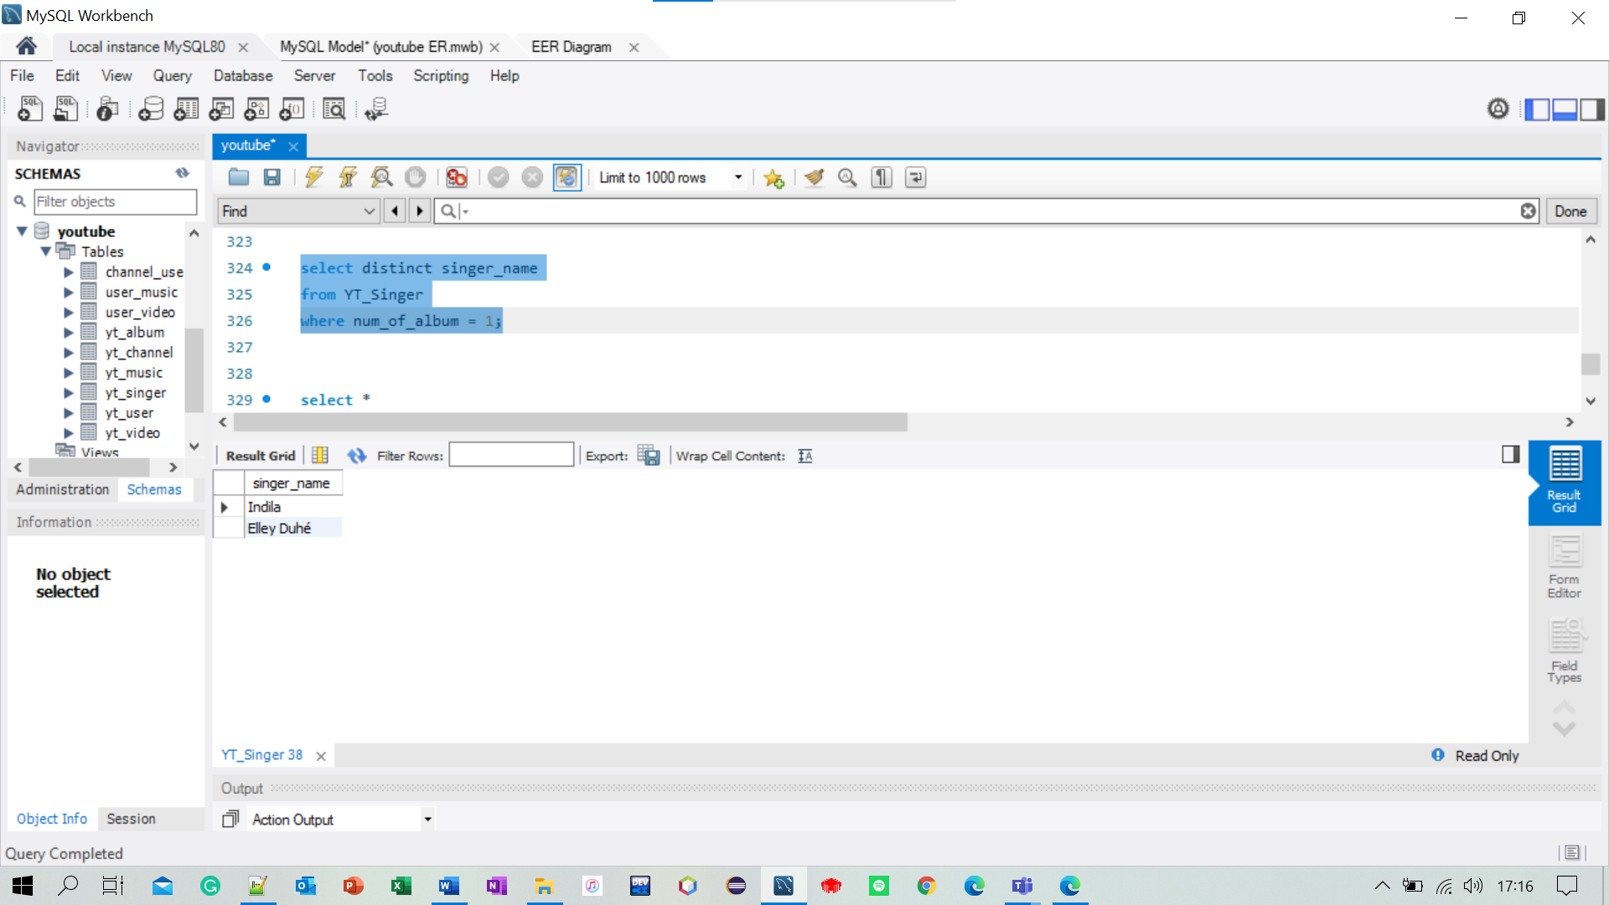
SELECT
select channel_name
from YT_channel;
select video_id, num_of_like as ‘total like of video’
from YT_video;
DISTINCT
select distinct album_name
from YT_Album
where num_of_song > 10;
select distinct singer_name
from YT_Singer
where num_of_album = 1;
WHERE
select *
from YT_User
where username like ‘B%’;
select duration_of_video
from YT_Video
where num_of_dislike < 500;
AND/OR
select username
from YT_User
where num_of_download = 5 and subscription_type = ‘Premium’;
select video_name, publication_date
from YT_Video
where num_of_like > 2000 or num_of_comment < 1000;

Slide 11
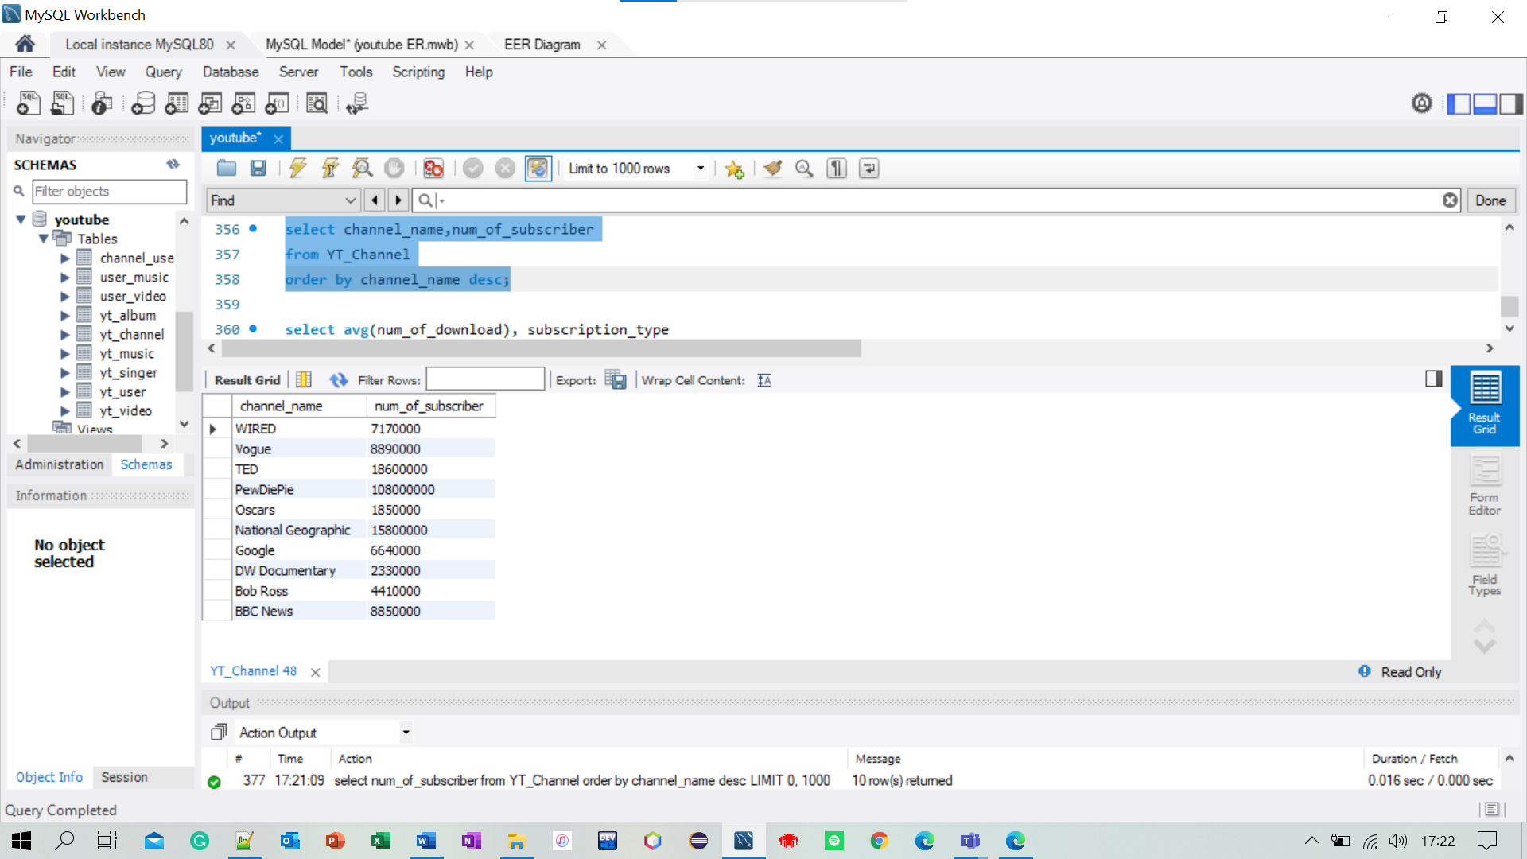
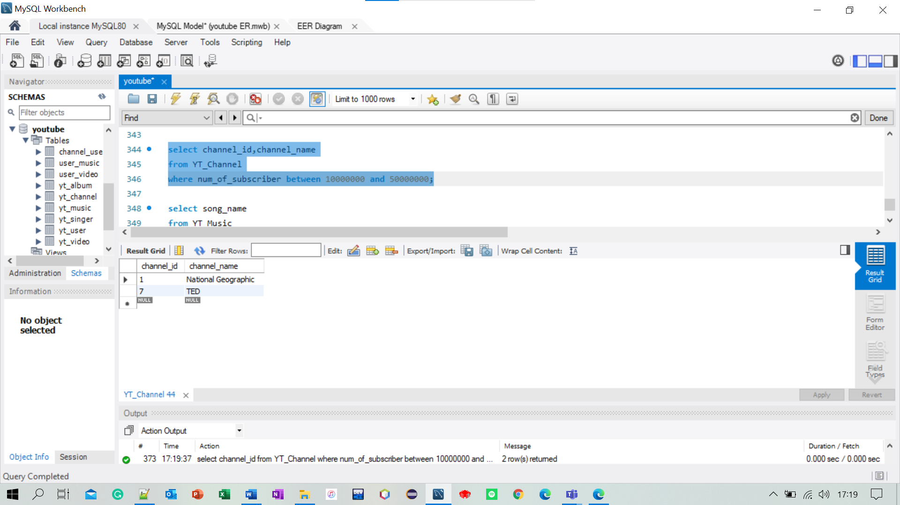
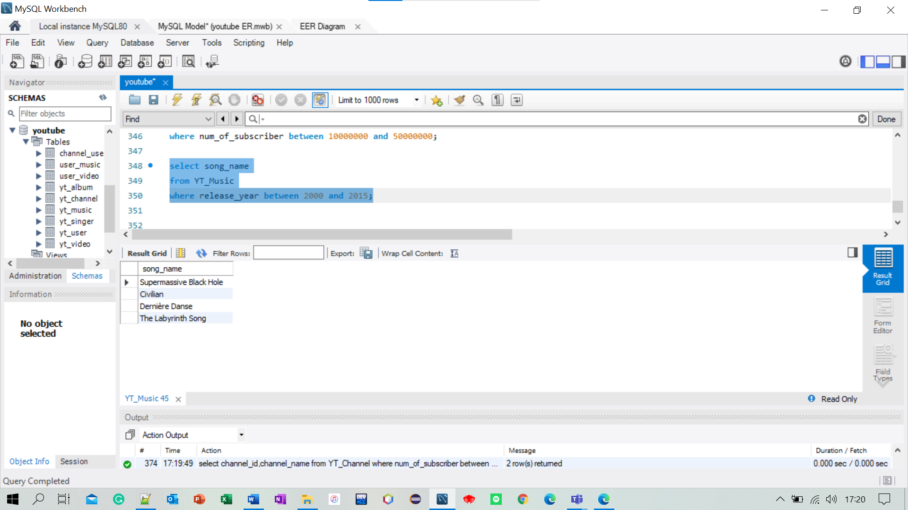
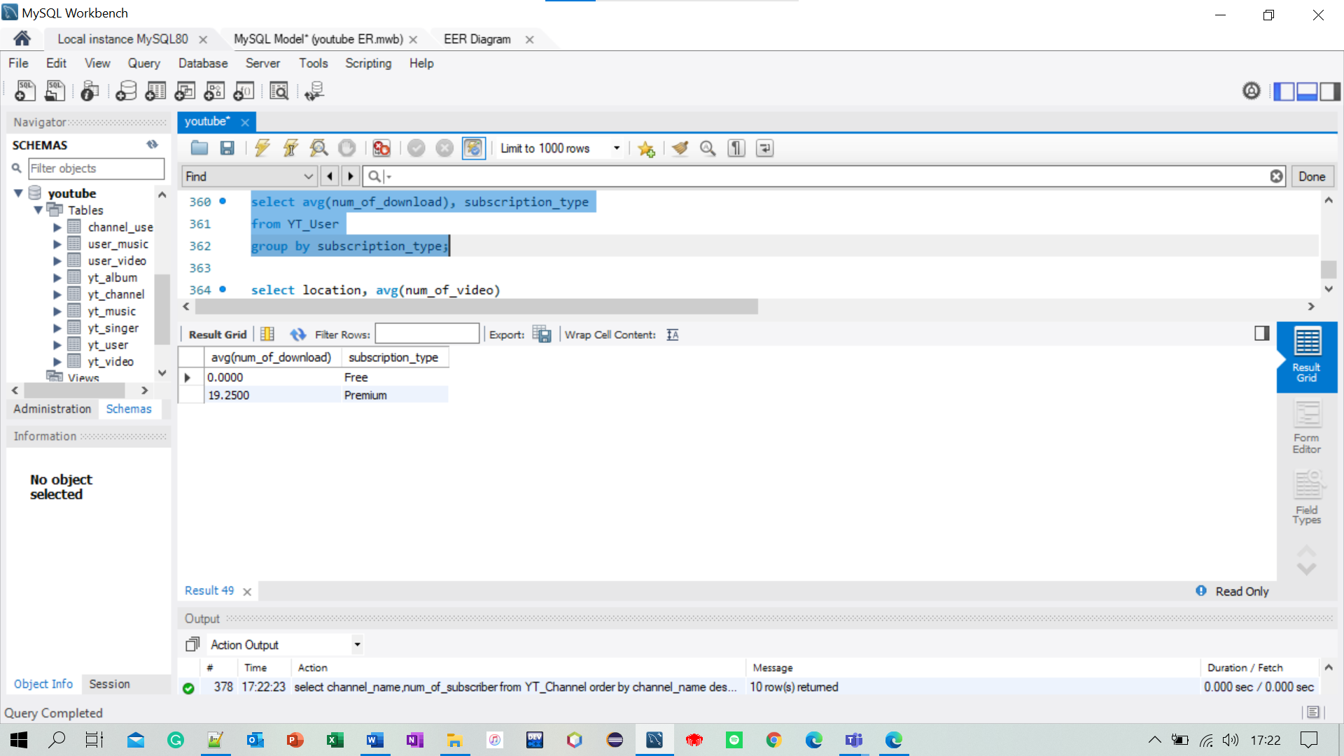
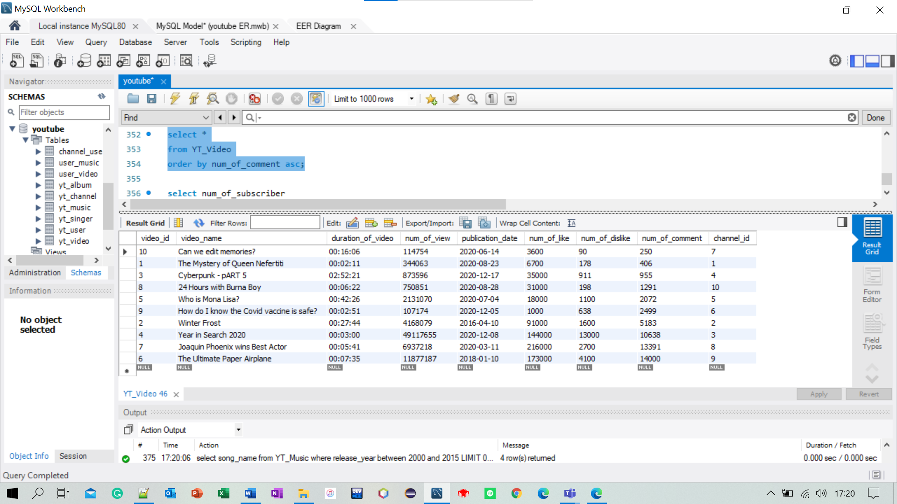
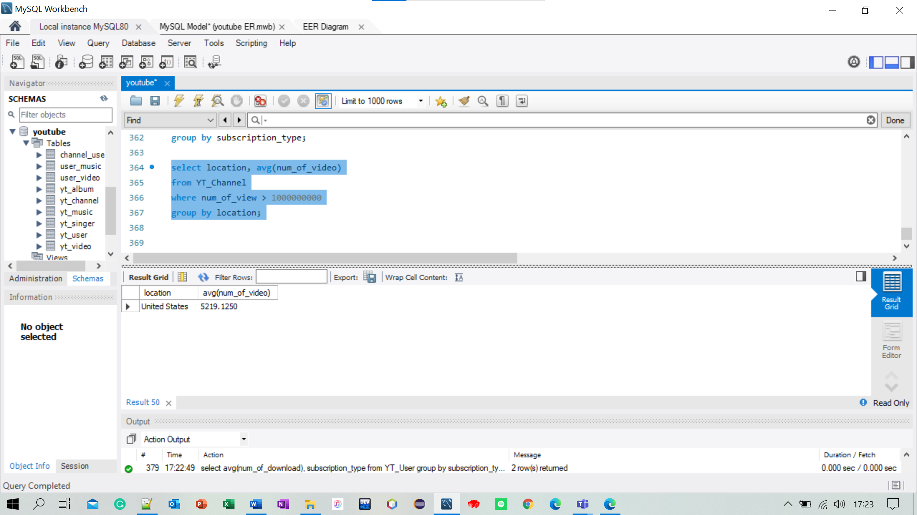
BETWEEN
select channel_id, chanel_name
from YT_Channel
where num_of_subscriber between 10000000 and 50000000;
select song_name
from YT_Music
where release_year between 2000 and 2015;
ORDER BY
select *
from YT_video
order by num_of_comment asc;
select channel_name, num_of_subscriber
from YT_Channel
order by channel_name desc;
GROUP BY
select avg(num_of_download), subscription_Type
from YT_User
group by subscription_type;
select location, avg(num_of_video)
from YT_Channel
where num_of_view > 1000000000
group by location;

